Slide 1
Investigation of Homoclinic Orbits in the Circular Restricted Three Body Problem
Luke Bury & Don Kuettel
05/02/18

Slide 2
Poincaré
Notes:
Use information from orbit determination, namely SRP
Second question – how do we pull shape information out? What do we want shape for?
Multi-model hypotheses – anything else possible?
Brdfs are too hard – want to ignore them
How to get shape information then?

Slide 3
The Competition

Slide 4
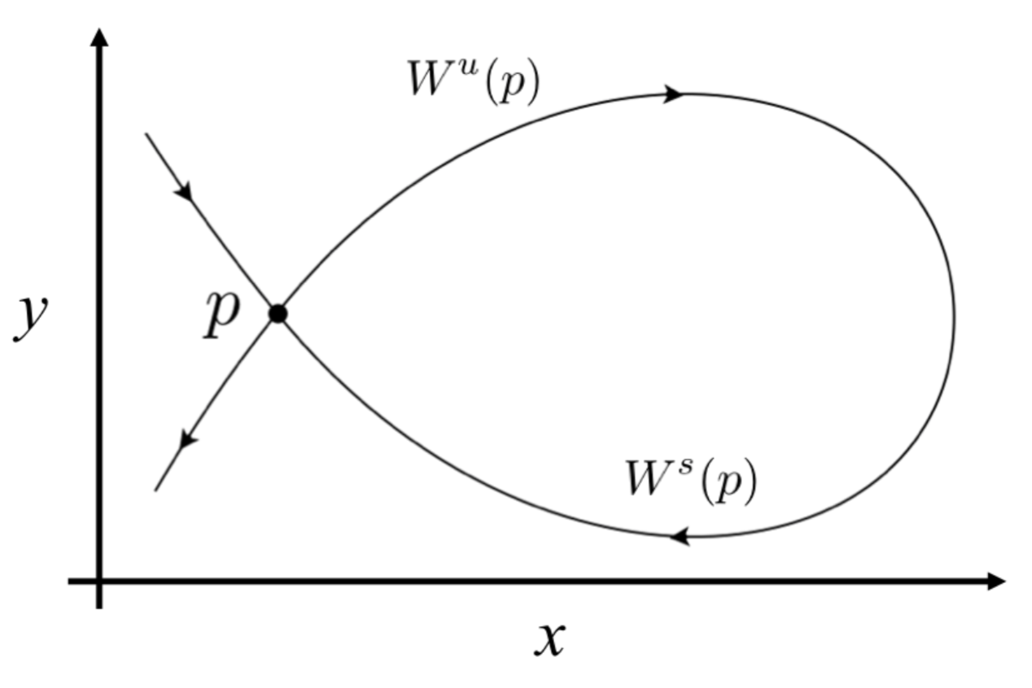
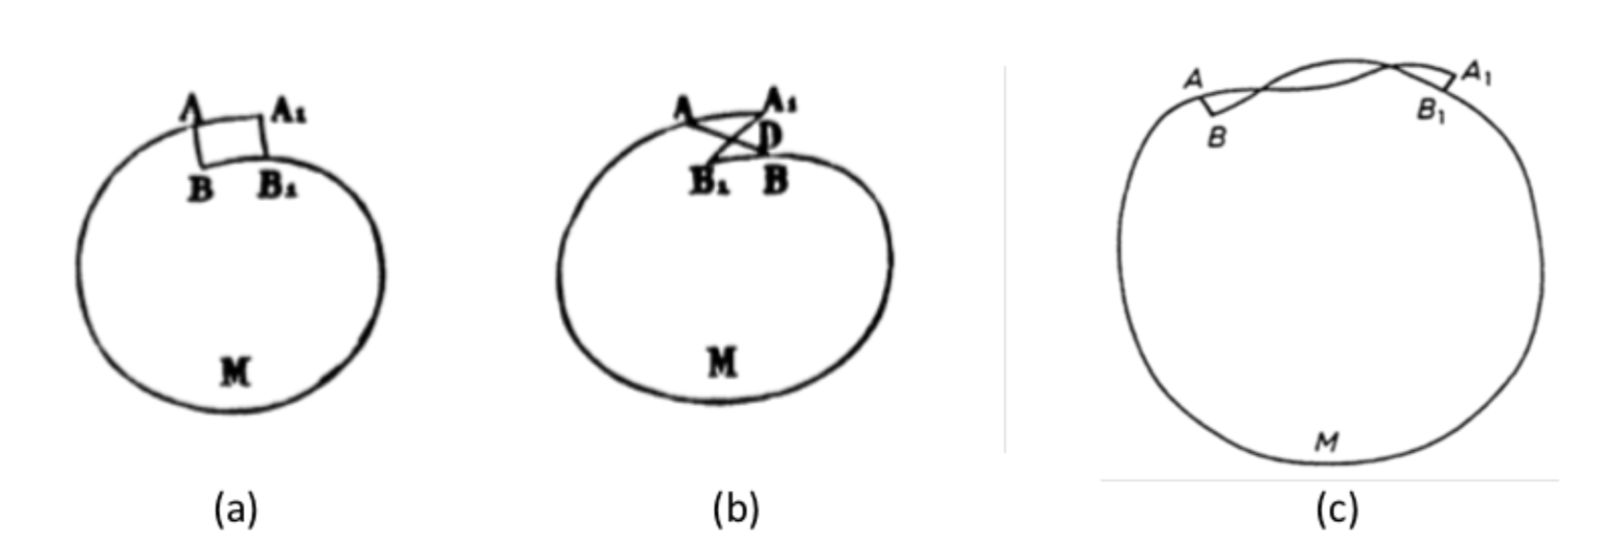
The Mistake & Homoclinic Orbits

Slide 5
Location of Homoclinic Orbits

Slide 6
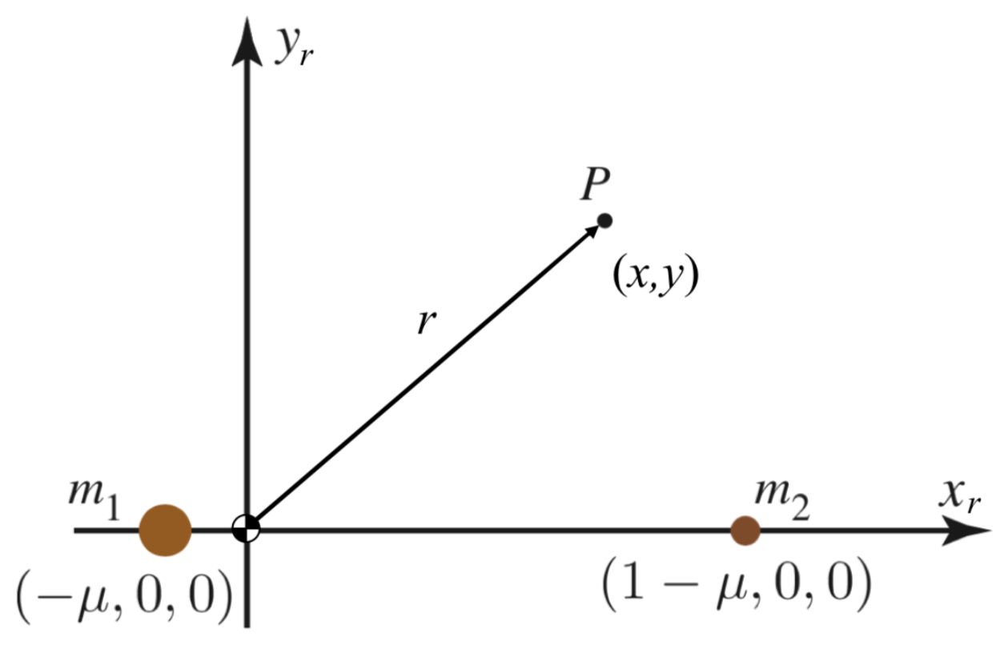
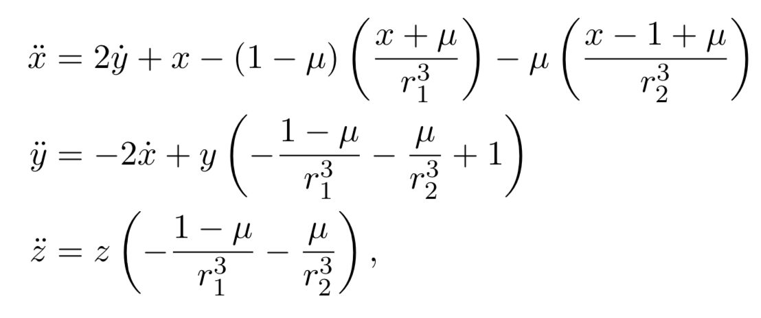
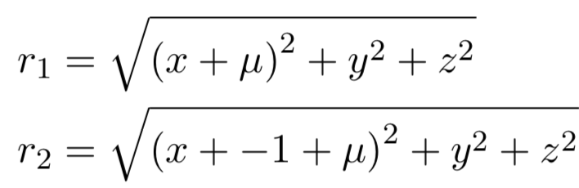
Circular Restricted Three Body Problem

Slide 7
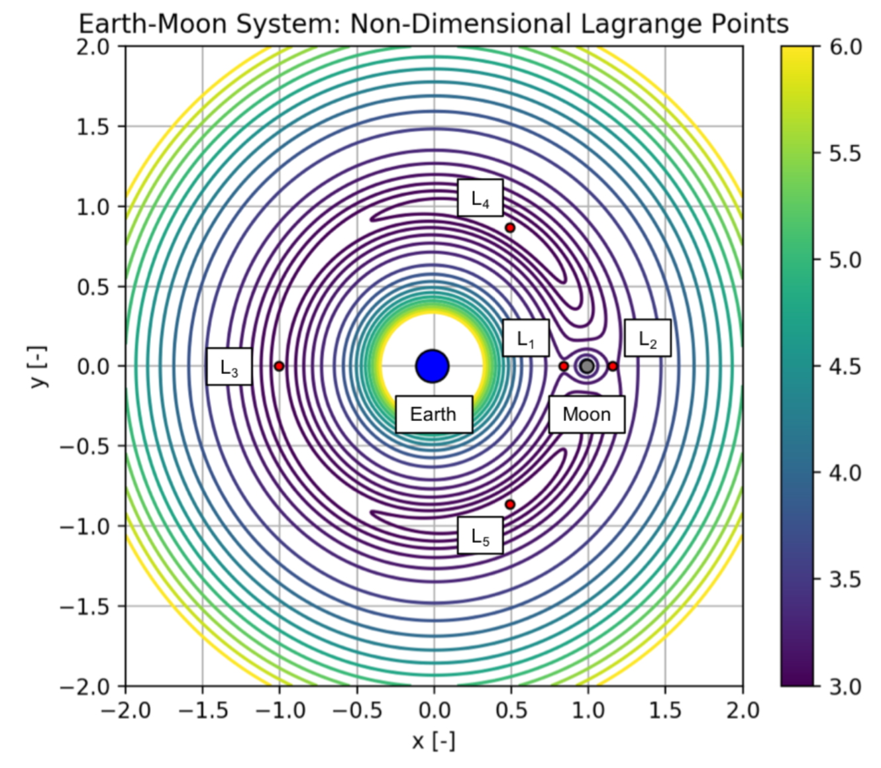
Equilibrium Points & Stability

Slide 8
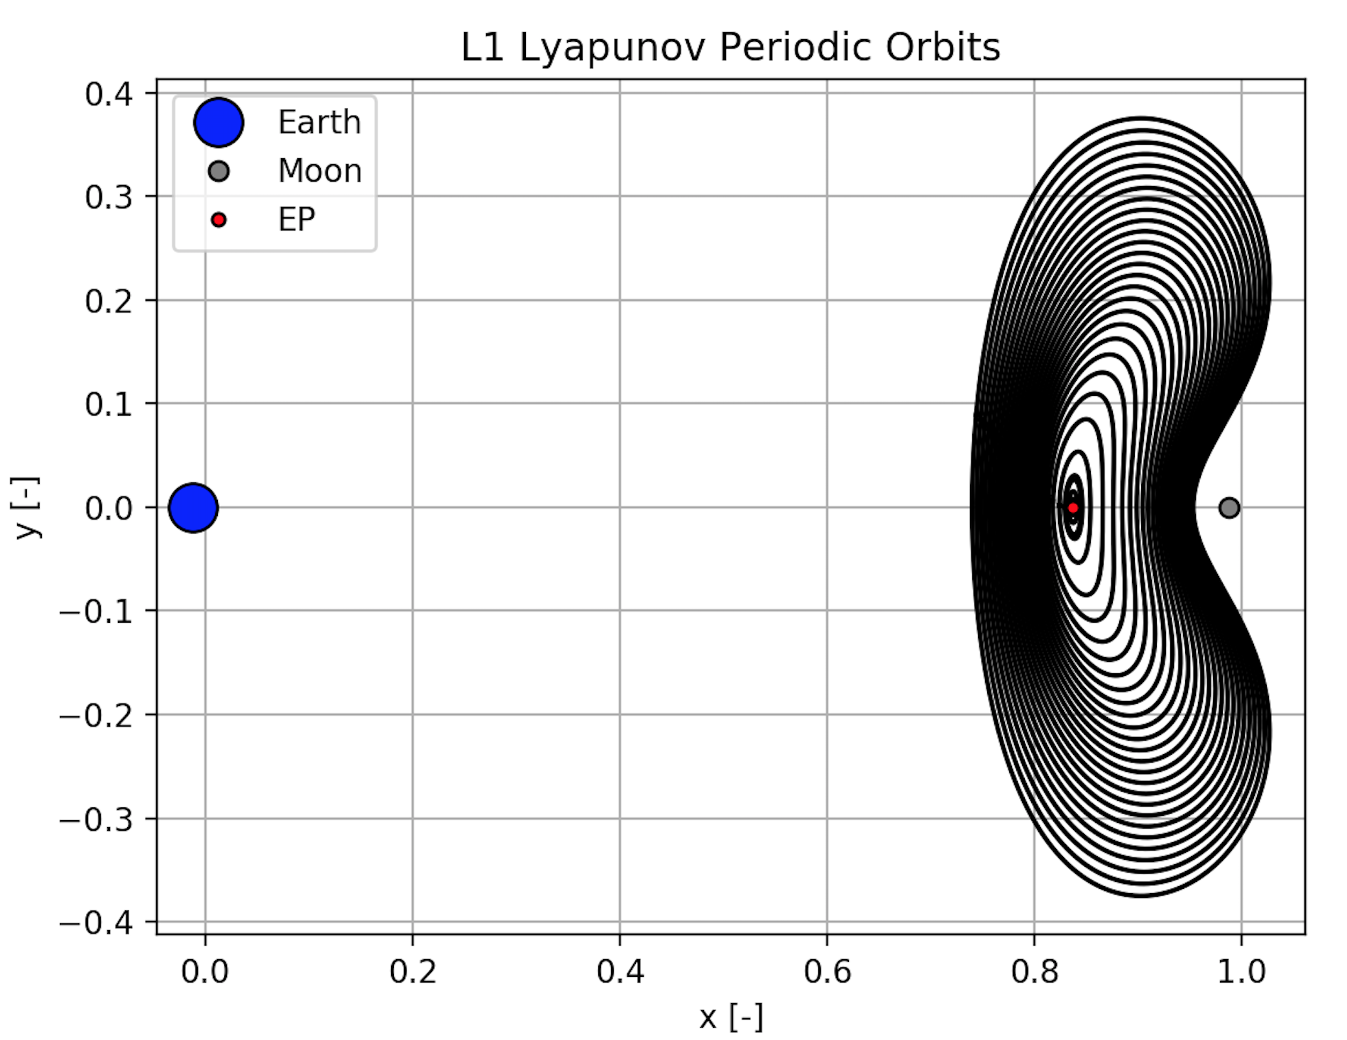
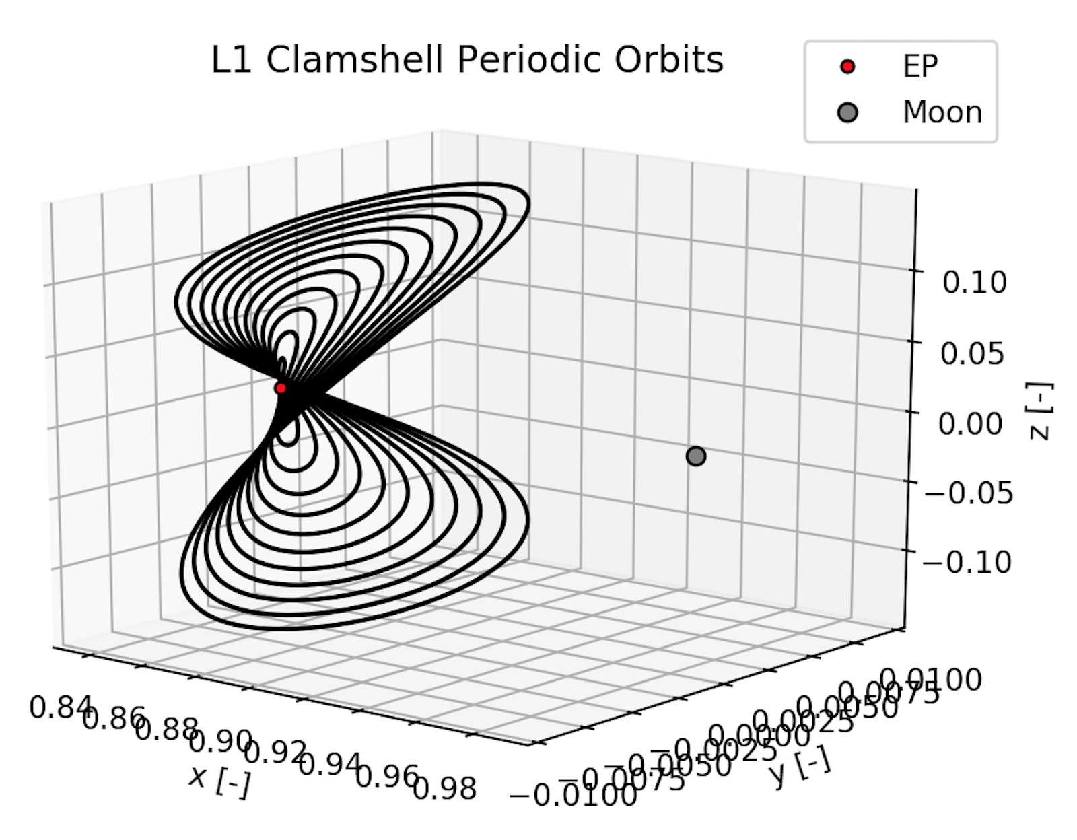
Periodic Orbits & Families

Slide 9
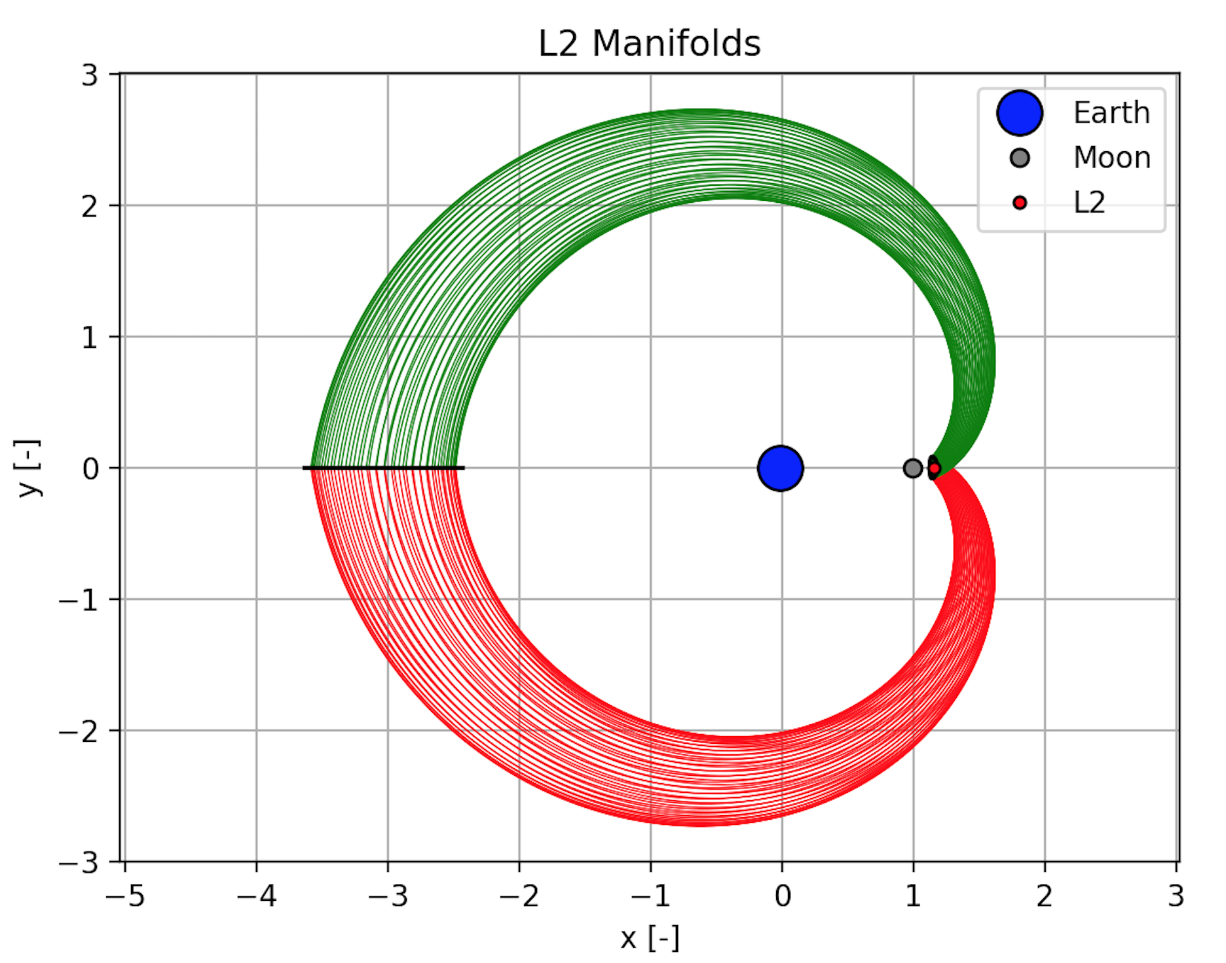
Manifolds

Slide 10
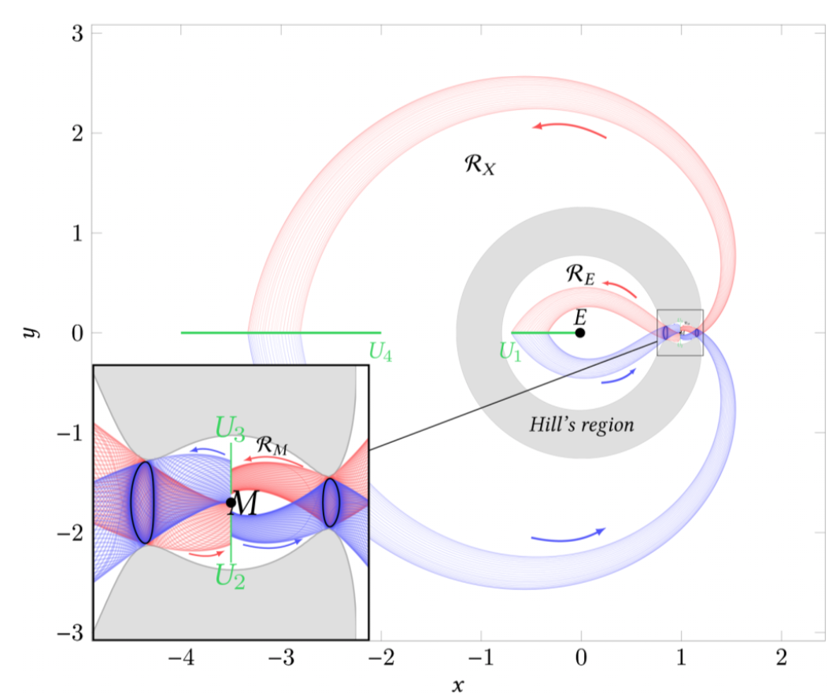
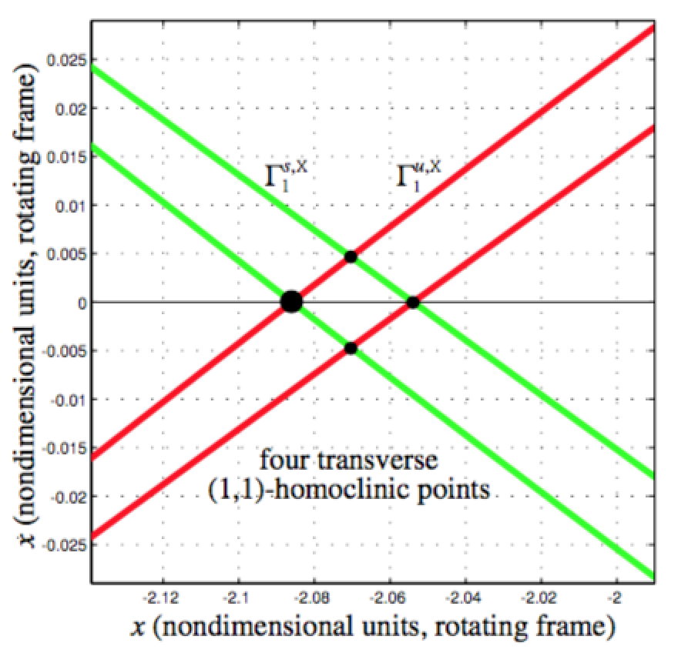
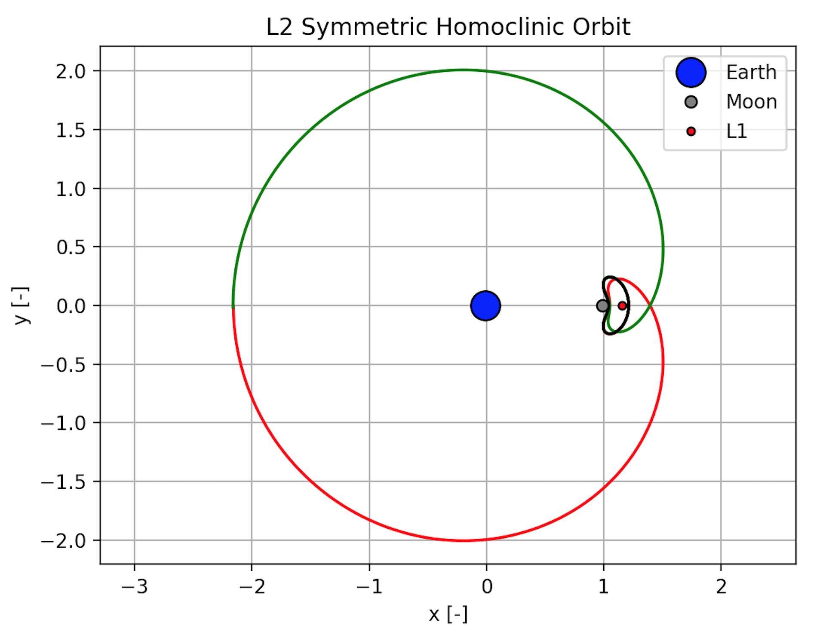
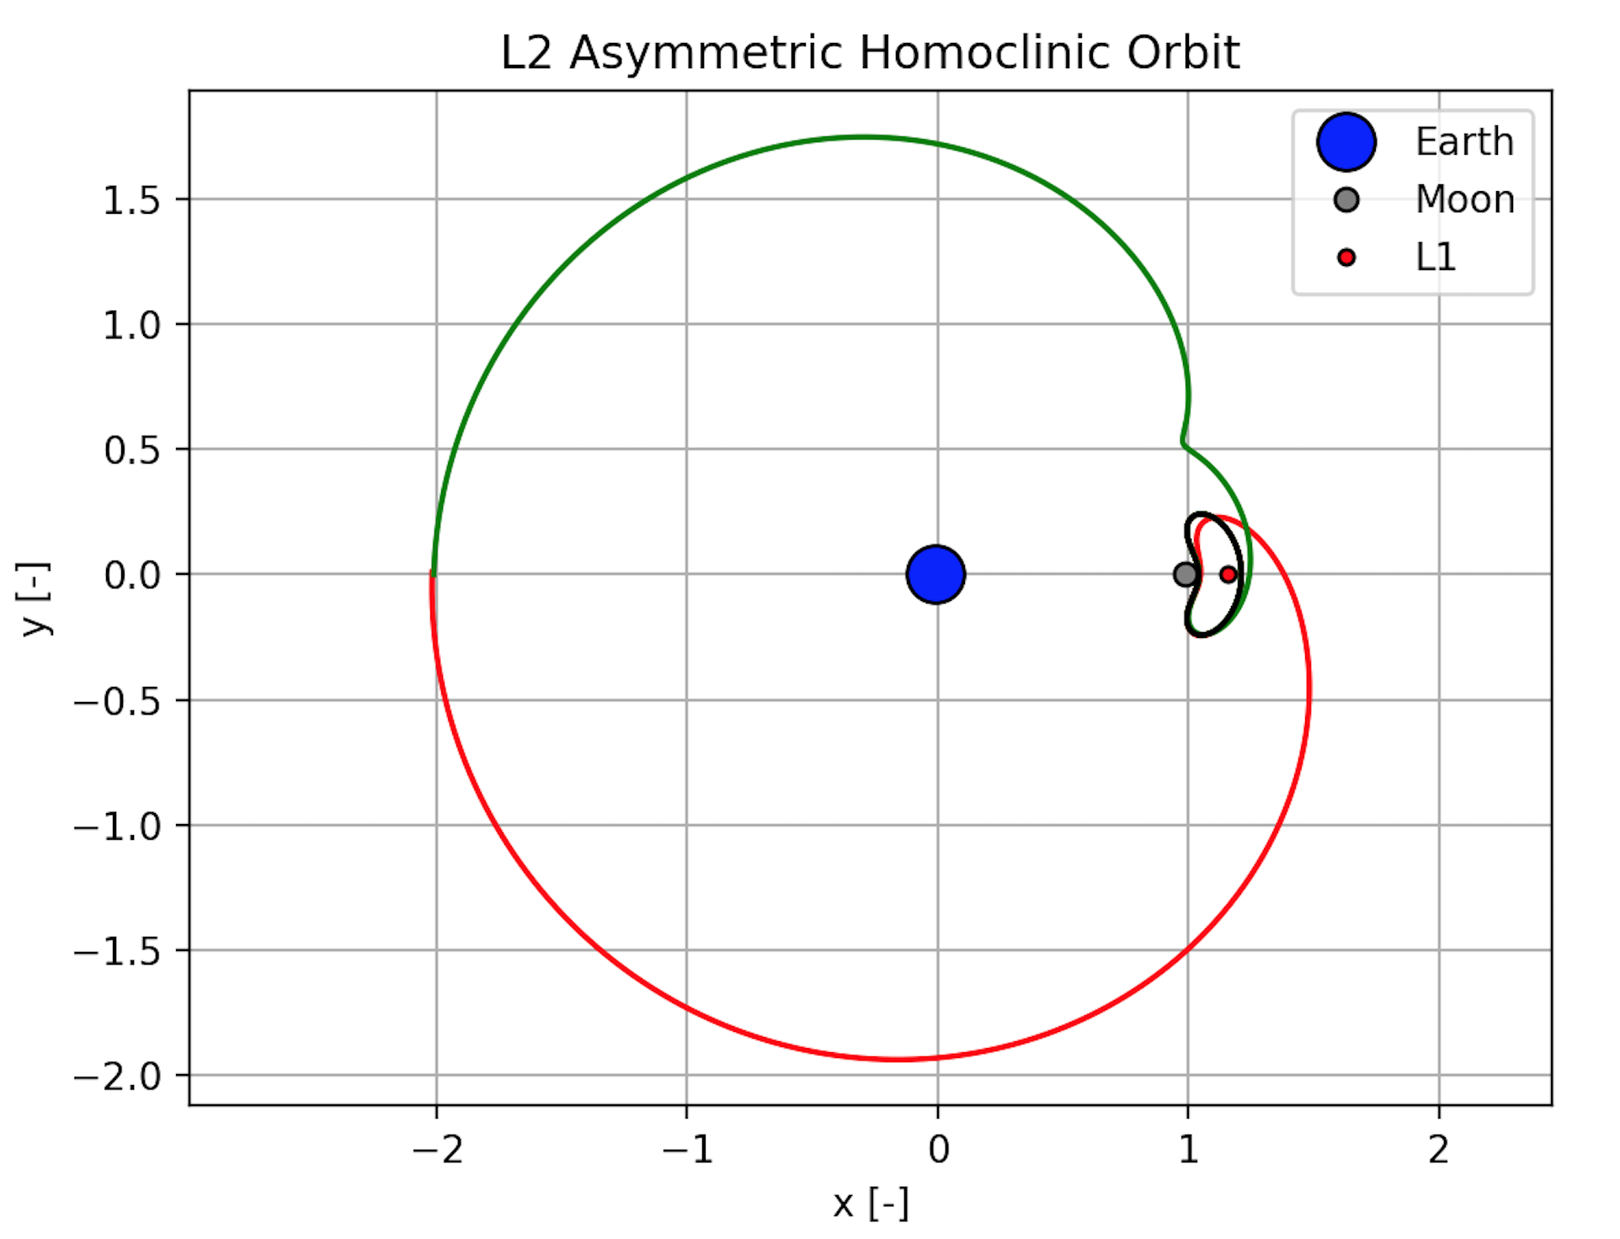
Poincaré Sections & Homoclinic Orbits
Notes:
Gonna need citations for all this stuff

Slide 11
Significance and Usefulness of Homoclinic Orbits
Notes:
-Homoclinic orbits can help understand flow of dynamic system, but for mission design, heterclinic orbits are of much greater use (moon transfers, etc)
-Can cite some papers

